Slide 1




Fitness Design
Plan for a Healthy Lifestyle
z

Slide 2
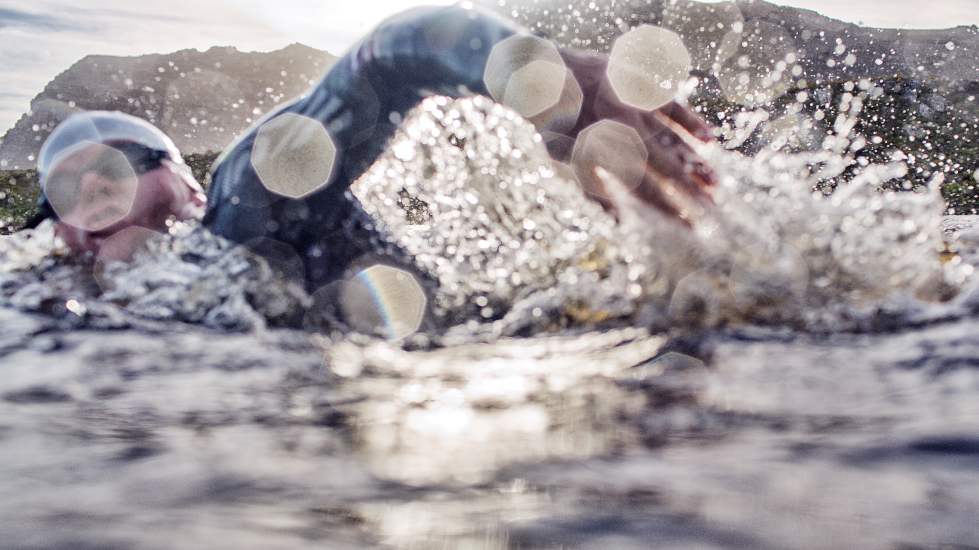
Requirements
Health
Diet
Exercise

Slide 3
Exercise Plan
z

Slide 4
Fitness Progress
Healthy Lifestyle
Diet
Exercise
Hydration
Immune System
Goals
Mental Attitudes
z

Slide 5

Thank You
z
someone@example.com

